Slide 1
Web Services
Mark Sapossnek
CS 651
Computer Science Department
Metropolitan College
Boston University

Slide 2
Learning Objectives
Understand the coming Web Services revolution
Fundamentals of Web Services
Be able to create and debug a Web Service
  Using the .NET Framework SDK
  Using Visual Studio.NET

Slide 3
Agenda
Web Services Overview
Underlying Technologies
Developing a Web Service
Consuming Web Services
Miscellaneous
.NET My Services

Slide 4
Web Services Overview
Business Today
CEO challenges
  Revamp customer service
  Overhaul supply chain
  Speed up the decision process
CIO challenges
  Reorient IT architecture
  Connect with a limitless number of external constituents
  Extend processes to external constituents
Notes:
Today’s businesses executives are facing challenges at different levels.
CEOs:
Re-vamping customer service offerings, including attracting new potential customers and retaining them
Renovating the supply chain, including minimizing cost and time to market
Speeding up the decision process
On another front, CIOs face different but related challenges…
Re-orienting IT architecture
Connecting with a limitless number of external constituents
Extending processes to external constituents

Slide 5
Web Services Overview
Internet Business Processes Span Companies
Notes:
The Internet is fundamentally changing computing—and consequently, it's fundamentally changing the way business is done. The shift to e-commerce is causing an immense ripple effect through corporate computing systems. Web sites are "growing backwards" as companies integrate their customer management and order fulfillment systems with their online sales systems. The next step is to extend that integration to business partners such as suppliers and distributors.
In addition to integrating various business systems across the Internet, there are several other service-related phenomena driving Web development. For example, customers are demanding richer, deeper, more personalized and more proactive services that add more value to their work or personal lives—services that work on their behalf while saving them time, money, and hassles.
The example continues with the next slide.

Slide 6
Web Services Overview
Technology Fabric Must Span Companies Too
Notes:
As a result, the Web is evolving from Web sites that simply serve up Web pages into dynamic Web services that interactively perform tasks involving multiple steps executed on a user's behalf. These tasks may require one Web service to call on other Web services, coordinating the steps much like a traditional software program executes commands. The problem today is that integrating with other services and touching different devices remains difficult, because tools and common conventions for interconnection are lacking.
What the Web needs is a common way to tie all these services together. For services to work together seamlessly, it must be easy to coordinate steps between services over the Internet and simple to create new and customized services. Developers must be able to integrate more than just services. They need to be able to assemble solutions from any combination of software components, applications, business processes, devices, or any other intellectual property. What's needed is a common perspective that lets developers harness together pieces from anywhere on the Internet—new application model that provides core programming services for distributed components to connect distributed services and components in a quick, reliable manner.
Historically, the solution for creating this kind of rich application-to-application communication has been to employ an object model such as Microsoft's DCOM or the Object Management Group's Internet Inter-ORB Protocol (IIOP) or Common Object Request Broker Architecture (CORBA). But these technologies have some limitations when it comes to creating Web services. In particular, DCOM and IIOP/CORBA are rich environments, which means that implementations and applications that use them tend to be complex and symmetrical. In other words, to build a distributed application using them, you typically need the same distributed object model running at both ends of the connection. But, the Internet doesn't guarantee what specific kind of client or server software is running at the other end of your connection, just that it speaks HTTP. Also, it is often politically or technically impractical to get everyone to run either IIOP or DCOM .
One response to this challenge is to use existing Internet standards: HTTP and XML.
More than any other application protocol, the Hypertext Transfer Protocol (HTTP) connects the world. Millions of Web sites and browsers speak it already. If you don't have an e-mail client, you can still use e-mail through a Website; if you want to use anything other than HTTP to connect over the Internet, you'll find that most other application protocols are tolerated at best and usually blocked out by firewalls.
The problem with HTTP alone is that it is mainly a mechanism for passing files from server to client. To create more ambitious Web services, you need to extend HTTP. SOAP does exactly that: it adds a set of HTTP headers and a rich XML payload to enable complex application-to-application communication over the Internet.

Slide 7
Web Services Overview
Drivers
Companies, suppliers, partners, and customers must be able to work together
  Faster than ever before
  Over the Internet
  Or risk “death by isolation”
Leverage Internet cost structure

Slide 8
Web Services Overview
Possible Solutions
Distributed computing
Web sites (portals)
Web Services

Slide 9
Web Services Overview
Distributed Computing
Client/server model
  Doesn‘t scale
  Not secure
Distributed object model
  Components: packaging and interoperability
  Remoting: remote method invocation
  COM, CORBA, Java RMI and EJB
    Not Internet-friendly
    Interoperability issues: poor/non-existent standards
    Tightly coupled: still doesn‘t scale

Slide 10
Web Services Overview
Distributed Computing
3-tier Application Architecture
  Great way to build scalable Web applications
But such applications are silos
  Integration is an afterthought
  They can be integrated behind the firewall
    Even that can be a problem
  They do not provide a way to integrate across the firewall (i.e. over the Internet)

Slide 11
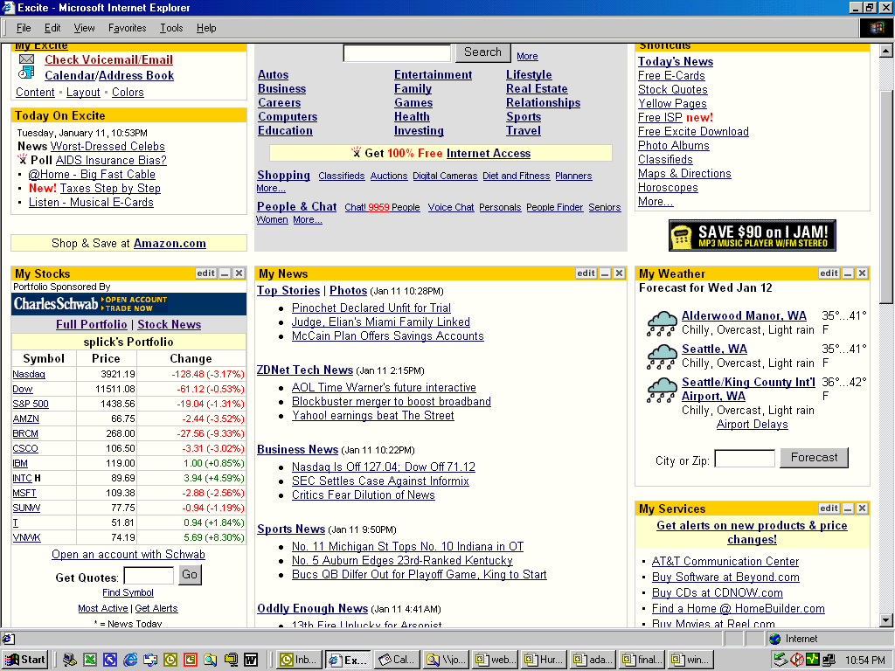
Web Services Overview
Portals
Ads
Mail
Other
Svcs
Calendar
Weather
Finance
News
Notes:
Take any of the large portals and break it down into its component parts and you have possible Web Services that could be aggregated. A portal like Yahoo gives you access to news, weather, email, calendaring, instant messages, stock quotes, various shopping services, white pages, yellow pages, personalization, and so on. Right now, Yahoo has to host most of these services itself, with a high infrastructure and development cost. If Yahoo could outsource key features, and have a choice of many suppliers of information, it could offer its consumers a broader selection of features and probably cut its costs.
Developers began to integrate multiple Web sites into their own, aggregating content from sites they may or may not control. This was more than linking to these sites, it meant your developers had to reverse-engineer the “APIs” of those sites (that is, to figure out what query strings to pass to the CGI applications). Then the developers had to “screen scrape” the HTML that came back as a result and re-purpose it.
The problem with all this work is that these other sites were never intended to be used like this. The machinations of how the CGI scripts URL-munge their parameters were meant to be hidden from end users. And the HTML that comes back was never meant to be treated as canonical – it changes from day to day and, consequently, the application that’s scraping the HTML will have to change from day to day. In all, this is a very brittle way of obtaining the information at another site. Just look at what happened when other auction sites tried to get access to eBay’s content: eBay was able to shut them out by making simple changes to the HTML.
Slightly better is the “your architect calls my architect” approach. Doing this means, at least, that some of the brittleness goes away, but at the cost of time to market. Most Web sites were never meant to be integrated like this, and as a result, it can take a long time to get two Web sites working together.
The solution is something we’re calling Web Services. In the Web Services model, today’s Web sites can expose their features as programmatic interfaces using Internet standards such as XML, and be treated as component building blocks.

Slide 12
Web Services Overview
Portal Limitations
No standard way to expose functionality
Integration is expensive and error-prone
Hard to outsource
Not designed to be used outside original scope
The problem?
  HTML is designed for presentation to people
  Can’t repurpose it in a general, reliable way
  Don’t even think about screen scraping

Slide 13
Web Services Overview
What Is a Web Service?
The solution? Web Services!
A Web Service exposes functionality to a consumer
  Over the Internet or intranet
  A programmable URL
  Functions you can call over the Internet
Based on Web standards
  HTTP, XML, SOAP, WSDL, UDDI, with more to come
Can be implemented in any language on any platform
Black boxes
  Component-like, reusable

Slide 14
Web Services Overview
What Is a Web Service?
A Web Service combines the best features of distributed computing and portals and eliminates the worst
  Provides a mechanism for invoking methods remotely
  Uses Web standards (e.g. HTTP, XML) to do so

Slide 15
Web Services Overview
What Is a Web Service?
Web Services allow you to interconnect:
  Different companies
  Many/any devices
  Applications
  Different clients
    Not just browsers
Distribution and integration of application logic
Enable the programmable Web
  Not just the purely interactive Web
Web Services are loosely coupled

Slide 16
Web Services Overview
What is a Web Service?
New paradigm for Internet development
Deliver applications as services
Richer, customer-driven experience
Continuous delivery of value/bits
Third-generation Internet
Notes:
We can define Web Services as the following:
A paradigm for Internet development
Deliver software as services
Richer, customer-driven experience
Accessible from any Internet-connected device
Continuous delivery of value/bits
Programmable

Slide 17


Web Services Overview Evolution of the Web
HTML, XML
HTML
HTML
HTML, XML
Generation 1
Static HTML
Generation 2
Web Applications
Generation 3
Web Services
Notes:
The first generation of Web applications was largely about delivering non-interactive content, i.e. publishing non-interactive HTML pages. For example, many applications simply operated in client/server mode and rendered HTML pages to send across the internet to browsers.
The second generation of Web applications was about creating applications usable over the Web. E-commerce is an example; you can go to http://www.barnesandnoble.com/ select books, order them and pay for them. This second generation also includes a more scalable back-end (e.g. WinDNA architecture) and a richer UI (e.g. DHTML and ActiveX).
However, useful though they may be, the second generation largely resulted in application islands on the Web. Yes, there are hyperlinks between sites, but for the most part, the actual applications at different sites do not interact.
The third generation of Web application is about using Web protocols and XML throughout to allow better integration between services on the Web. Protocols such as XML and SOAP allow you to create Web Services, enabling people and companies to easily create integrated applications.

Slide 18
Web Services Overview
Benefits
Everyone
  Leverage existing infrastructure
  “Build or buy” development decisions
  Minimize development time/costs
Enterprises
  Integration imperative
  Dynamic, easy B2B relationships
New Web-based businesses
  Greater personalization
  New services/new revenue streams
  Be “everywhere” vs. single destination
Notes:
Web Services delivers on the promise of componentware.
There are benefits for everyone and benefits in particular for: Enterprises in terms of interoperability between heterogeneous systems, and Simplified Business-to-Business (B2B) relationships.

Slide 19
Web Services Overview
Possibilities
Scenario: Planning a trip
  Go to Expedia site (or Travelocity, or …)
  Log in by clicking .NET Passport icon
  Find the flights you want
    Don’t have to reenter seat/meal/airline/frequent flyer/… info
    System can find lowest price fare by looking at your calendar(s)
  Purchase tickets w/o entering credit card #
  Flight info automatically added to your calendar and your spouse’s calendar
  Book rental car/hotel w/your preferences; added to calendar
  On day of trip get notified of flight status via email/toast/pager/cell phone

Slide 20
Web Services Overview
Possibilities
Web Services videos
  Healthcare
  Family
  Business

Slide 21






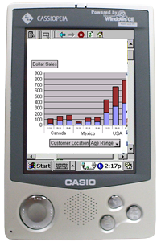
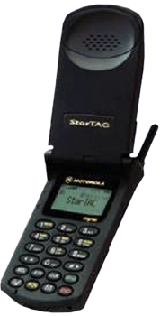
Web Services Overview
Application Model
Partner
Web Service
Other Web Services
Partner
Web Service
Internet + XML
End Users
YourCompany.com
Application Business Logic Tier
Data Access and Storage Tier
Other Applications
Notes:
This graphic depicts a possible scenario in the near future and some of the key players…
The end user interacts/consumes many different services through a variety of devices including PCs, cellular phones, hand-held devices (e.g., the PocketPC).
The Internet is the communication channel that facilitates all these interactions.
This slide also shows the interaction between different organizations; for example, YourCompany.com and its relationship with its partner companies.
You should also consider that the bandwidth per dollar is growing by 300 percent each year. This is even faster than Moore’s Law of microprocessor power. With all this bandwidth, we’re now seeing all kinds of different devices connected to the Internet, including palm computers and wireless phones.

Slide 22













Web Services Overview
Sample Web Services
.NET Inbox
.NET Alerts
.NET Calendar
.NET Application Settings
.NET Contacts
.NET Documents
.NET Lists
.NET Devices
.NET Categories
.NET Location
.NET FavoriteWebsites
.NET Presence
.NET Profile
.NET Wallet
Notes:
This figure depicts a series of possible Web Services and the building blocks that compose them, like:
MS Passport – part of MSN
Email
Etc.
This figure also shows how they relate to your site using the Web Services infrastructure that we’ll discuss later in this presentation: SDL, Disco, SOAP, etc.
Instead of using HTTP + HTML for presentation only, the idea is to send and receive information / method calls / results / etc.
Later you’ll be able to integrate these Web Services into your own apps - services like Hotmail and Passport doing service aggregation. And for that you’ll have tools like the SOAP Toolkit (sooner) and VS7 (later) to make this very easy.

Slide 23
Web Services Overview
Sample Web Services
E-commerce: order books, office supplies,
other products
Track packages: UPS, FedEx
Weather
Maps
Telephone redirection, customizable rules
and messages

Slide 24
Agenda
Web Services Overview
Underlying Technologies
Developing a Web Service
Consuming Web Services
Miscellaneous
.NET My Services

Slide 25
Underlying Technologies
XML Is the Glue
XML
HTML
TCP/IP
Technology
Connectivity
Presentation
Connecting
Applications
Innovation
FTP, E-mail, Gopher
Connect
the Web
Web Pages
Browse
the Web
Web Services
Program
the Web

Slide 26
Underlying Technologies
Web Services Stack
Directory: Publish & Find Services: UDDI
Inspection: Find Services on server: DISCO
Description: Formal Service Descriptions: WSDL
Wire Format: Service Interactions: SOAP
Universal Data Format: XML
Ubiquitous Communications: Internet
Simple, Open, Broad Industry Support

Slide 27
Underlying Technologies
Web Services Stack
Discovery
  Directory allows potential clients to locate relevant Web Services
    UDDI
  Inspection allows you to locate documents about Web Services located on at a given URL
    DISCO
  A Description language defines the format of methods provided by a Web Service
    WSDL

Slide 28
Underlying Technologies
Web Services Stack
UDDI
Directory
http://www.uddi.org
UDDI or
other
directory
service
Locate a Service
Link to Discovery Document (XML)
Inspection
http://www.ibuyspy.com/ibuyspy.disco
DISCO
Request Discovery Document
Return Discovery Document (XML)
Web Service Client
WSDL
Description
http://www.ibuyspy.com/ibuyspycs/InstantOrder.asmx?wsdl
Request Service Description
Web Service
Return Service Description (XML)
SOAP
Wire Format
Request Service
Return Service Response (XML)

Slide 29
Underlying Technologies
Web Service Wire Format
The Web Service Wire Format specifies how specific messages are exchanged
  HTTP-GET
  HTTP-POST
  SOAP
HTTP-GET and HTTP-POST use a minimal HTTP interface to invoke Web Services
  Limited support for data types
SOAP provides a robust HTTP/XML interface
  Extensive support for data types

Slide 30
XML Overview
XML Basics
XML is designed to represent and transfer structured data
  In HTML: <p>Jan 15, 2000 </p>
  In XML: <OrderDate>Jan 15, 2000</OrderDate>
XML does not display or transform data
  XML separates data from formatting and transforming
  HTML and XML are both derived from SGML
    In different ways
Notes:
The power and beauty of XML is that it separates the user interface from the structured data. While HTML specifies how to display data in a browser, XML defines the content. For example, in HTML, you use tags to tell the browser to display data as bold or italic; in XML you only use tags to describe data, such as city name, temperature, and barometric pressure. In XML, you use XSLT or CSS style sheets to present the data in a Web browser. XML separates the data from the presentation and the process, enabling you to display and process the data as you wish by applying different style sheets and applications.
This separation of data from presentation enables the seamless integration of data from diverse sources. Customer information, purchase orders, research results, bill payments, medical records, catalog data, and other information can be converted to XML on the middle tier, allowing data to be exchanged online as easily as HTML pages display data today. Data encoded in XML can then be delivered over the Web to the desktop. No retrofitting is necessary for legacy information stored in mainframe databases or documents. And because the HTTP protocol is used to deliver XML over the Internet, no changes are required for this function.
The W3C working draft for XSLT divides the language into two main parts: a transformation language for XML documents (XSLT), and an XML vocabulary for formatting semantics.

Slide 31
XML Overview
XML Syntax
XML is composed of tags and attributes
  Tags can be nested
    Representing entities, entity properties, and entity hierarchy
<ROOT>
<Orders OrderID="10643" CustomerID="ALFKI" EmployeeID="6" OrderDate="1997-08-25T00:00:00" RequiredDate="1997-09-22T00:00:00" ShippedDate="1997-09-02T00:00:00" />
</ROOT>
Notes:
XML documents are composed, basically, of element tags and attributes. There are also other types of structures, like entities, entity references, reference nodes, and comments, but for this session, we will only review two definitions:
Element
An XML structural construct. An XML element consists of a start tag, an end tag, and the information between the tags; that is, the contents. Each element has a type, identified by name, sometimes called its "generic identifier" (GI), and may have a set of attribute specifications. Each attribute specification has a name and a value. An instance of an element is declared using <ELEMENT> tags.
Attribute
Another XML structural construct. A name-value pair, separated by an equals sign (=), included inside a tagged element that modifies certain features of the element. All attribute values, including things like size and width, are in fact text strings and not numbers. For XML, all values must be enclosed in double quotation marks (“XXX”).
In the node tree of an XML document, you can nest the tags, so the element children can be attributes or other elements.
In the code shown in the slide, you can see how the ROOT node has a “child” node named Orders. This in turn has six attribute children: OrderID, CustomerID, EmployeeID, OrderDate, RequiredDate and ShippedDate.
Note that Orders is an “empty” (no text data in it) tag. XML has a shorthand for an empty element: A single beginning tag ending with an /> signals that the element has no content.

Slide 32
XML Overview
XML Schemas
XML schemas describe the structure of an XML document
  XML schemas describe the tag and attribute specifications
    Simple and compound data types
  XML schemas also describe constraints on the contained text
  XML schemas and the DTD are mutually exclusive
Notes:
A schema is a formal specification of the rules of a particular XML document, namely the element names. The schema indicates which elements are allowed in a document and in what combinations. New schema languages, such as those defined in the XML-Data Working Group XML-Data and Document Content Description (DCD) proposals submitted to the W3C, provide the same functionality as a DTD. However, because these schema languages are extensible, developers can augment them with additional information, such as data types, inheritance, and presentation rules. This makes these new schema languages far more powerful than DTDs.
With XML-Data and DCD, Microsoft and others have proposed vocabularies for expressing the schema of an XML document using XML itself. This allows XML data to describe its own structure. Expressing schemata within XML adds great power to the XML format, because it is then possible for software examining certain data to understand its structure without having any prior built-in descriptions of the data's structure.
Using a schema, an author can define precisely which element names are permitted in a document and, within each element, which sub-elements, attributes, and relations are allowed. An author can import fragments from other schemata, and extend types through inheritance. This allows complex relationships between elements, while retaining the simplicity of a lexical tree structure.

Slide 33
SOAP
Overview
A lightweight protocol for exchanging information in a distributed, heterogeneous environment
  It enables cross-platform interoperability
Interoperable
  OS, object model, programming language neutral
  Hardware independent
  Protocol independent
Works over existing Internet infrastructure
Notes:
Earlier on, we defined SOAP as the protocol used by Web Consumers for sending requests and receiving responses from Web Services.
More formally, “SOAP is a lightweight protocol for exchanging information in a decentralized, distributed environment” (W3C). By lightweight, we mean that it sits on top of other protocols to handle the actual transmission of data. SOAP currently uses HTTP.
It is being adopted as an industry standard, and its function is to improve cross-platform functionality. The strength of SOAP is its simplicity, and the fact that it is based on other industry standard technologies - HTTP and XML.
The SOAP specification defines a number of things. The most important are:
The format of a SOAP message
How data should be encoded
How to send messages (method calls)
How to receive responses

Slide 34
SOAP
Overview
Guiding principle: “Invent no new technology”
Builds on key Internet standards
  SOAP ≈ HTTP + XML
  Submitted to W3C
The SOAP specification defines:
  The SOAP message format
  How to send messages
  How to receive responses
  Data encoding
Notes:
SOAP provides a simple and lightweight mechanism for exchanging structured and typed information between peers in a decentralized, distributed environment using XML.
For more information go to:
http://msdn.microsoft.com/workshop/xml/general/soapspec.asp
SOAP can potentially be used in combination with a variety of other protocols; however, the only bindings defined in this document describe how to use SOAP in combination with HTTP and the HTTP Extension Framework.

Slide 35
SOAP
SOAP Is Not…
Objects-by-reference
  Distributed garbage collection
  Bi-directional HTTP
Activation
Complicated
  Doesn’t try to solve every problem in distributed computing
  Can be easily implemented
Notes:
SOAP is not objects-by-reference (which requires distributed garbage collection and bi-directional HTTP).
SOAP is not activation (which requires objects-by-reference). Objects are put into the SOAP XML message as a stream and unpacked by a listener. Then the object is a created, activated, and the specified method is called.

Slide 36
SOAP
The HTTP Aspect
SOAP requests are HTTP POST requests
POST /WebCalculator/Calculator.asmx HTTP/1.1
Content-Type: text/xml
SOAPAction: “http://tempuri.org/Add”
Content-Length: 386
<?xml version=“1.0”?>
<soap:Envelope ...>
...
</soap:Envelope>
Notes:
SOAP actually uses HTTP POST requests to send data. The slide highlights the HTTP aspects of a SOAP request (in gold).
The example on the slide shows the HTTP POST request invoked by the WebCalculator client used in an earlier demonstration. The URI (/WebCalculator/Calculator.asmx) is implementation specific, and how the server handling the SOAP request (in this case IIS) interprets it is up to the server.
The other important features are the Content-Type, which must be text/xml, and the SOAPAction which contains a concatenation of a namespace, and a method name. The SOAPMethodName indicates the intent of the SOAP request. An administrator can use tools to filter HTTP requests based on this information, and maybe reject them if they are inappropriate.
The body of the SOAP request is held in the <soap:Envelope> element (described next)

Slide 37
SOAP
Message Structure
SOAP Message
The complete SOAP message
Headers
Protocol binding headers
SOAP Envelope
<Envelope> encloses payload
SOAP Header
<Header> encloses headers
Headers
Individual headers
SOAP Body
<Body> contains SOAP message name
Message Name & Data
XML-encoded SOAP message name
& data
Notes:
A SOAP message is an XML document that consists of a mandatory SOAP envelope, an optional SOAP header, and a mandatory SOAP body.
The envelope is the top element of the XML document representing the message.
The header is a generic mechanism for adding features to a SOAP message in a decentralized manner without prior agreement between the communicating parties. SOAP defines a few attributes that can be used to indicate who should deal with a feature and whether it is optional or mandatory. The Body is a container for mandatory information intended for the ultimate recipient of the message.
SOAP defines one element for the body, which is the Fault element used for reporting errors.

Slide 38
SOAP
SOAP Message Format
An XML document using the SOAP schema:
<?xml version=“1.0”?>
<soap:Envelope ...>
<soap:Header ...>
...
</soap:Header>
<soap:Body>
<Add xmlns=“http://tempuri.org/”>
<n1>12</n1>
<n2>10</n2>
</Add>
</soap:Body>
</soap:Envelope>
Notes:
The body of the request, or payload, is an XML document that uses a SOAP defined schema. It comprises a single <soap:Envelope> that can contain zero or more <soap:Header> elements, and a <soap:Body> element.
A <soap:Header> element can be used to convey optional application and server specific information about the request – transactional attribute information for example. Again, how the server interprets the contents of the header is up to the server. A server can even ignore a <soap:Header> unless the mustUnderstand attribute is set to “true”.
The <soap:Body> element contains the details of the request – usually the method to be interpreted (executed) by the server, and the values of any parameters. The method must match exactly with the method specified in the HTTP SOAPAction header. If it does not, the SOAP protocol specifies that the server must reject the request.
The example shown on the slide is the payload for an Add request issued by a Web Service consumer. The parameters n1 and n2 can also be seen.

Slide 39
SOAP
Server Responses
Server replies with a “result” message:
HTTP/1.1 200 OK
...
Content-Type:text/xml
Content-Length: 391
<?xml version=“1.0”?>
<soap:Envelope ...>
<soap:Body>
<AddResult xmlns=“http://tempuri.org/”>
<result>28.6</result>
</AddResult>
</soap:Body>
</soap:Envelope>

Slide 40
SOAP
Encoding Complex Data
Data structures are serialized as XML:
<soap:Envelope ...>
<soap:Body>
<GetStockDataResult xmlns=“http://tempuri.org/”>
<result>
<Description>Plastic Novelties Ltd</Description>
<Price>129</Price>
<Ticker>PLAS</Ticker>
</result>
</GetStockDataRseult>
</soap:Body>
</soap:Envelope>

Slide 41
SOAP
Security and Features
Builds on HTTP Security
  HTTPS
  X.509 certificates
Developers / IT choose which methods to expose explicitly
Does not pass application code
Firewall-friendly
Type safe
Notes:
Since SOAP uses the existing Internet infrastructure (e.g., HTTP) it inherits all the security mechanisms available:
HTTPS
Certificates, etc.
And it doesn’t require a special consideration for firewalls, because as explained before, it uses HTTP.
There are others “vehicles” under consideration; for example: SMTP, Microsoft Message Queuing Services (MSMQ), etc…

Slide 42
SOAP
Industry Support
DevelopMentor Inc.
Digital Creations
IONA Technologies PLC
Jetform
ObjectSpace Inc.
Rockwell Software Inc.
SAP
Compaq
Microsoft
Rogue Wave Software Inc.
Scriptics Corp.
Secret Labs AB
UserLand Software Inc.
Zveno Pty. Ltd.
IBM
Hewlett Packard
Intel
Notes:
These are some of the companies supporting SOAP and providing or integrating their tools with it.
Others are: Commerce one, Component Source, UserLand Software, etc.

Slide 43
SOAP
Example of a SOAP Request
POST /StockQuote HTTP/1.1
Host: www.stockquoteserver.com
Content-Type: text/xml;
charset="utf-8"
Content-Length: nnnn
SOAPAction: "Some-URI“
<SOAP-ENV:Envelope xmlns:SOAP-ENV="http://schemas.xmlsoap.org/soap/envelope/"
SOAP-ENV: encodingStyle = "http://schemas.xmlsoap.org/soap/encoding/">
<SOAP-ENV:Body>
<m:GetLastTradePrice xmlns:m="Some-URI">
<symbol>DIS</symbol>
</m:GetLastTradePrice>
</SOAP-ENV:Body>
</SOAP-ENV:Envelope>
Notes:
The call is to a StockQuote server, and the method is GetLastTradePrice. The method takes one string parameter, called ticker, and returns a float.
It uses the SOAP namespace to disambiguate SOAP keywords in the payload and a method namespace to disambiguate method keywords in the payload.
The root Envelope element tag name is used to disambiguate SOAP XML encodings.
Following is an example of the SOAP encoding required to make this method call. This example uses the familiar HTTP verb POST. SOAP also supports the use of the HTTP verb M-POST for extensibility.

Slide 44
SOAP
Example of a SOAP Response
HTTP/1.1 200 OK
Content-Type: text/xml;
charset="utf-8"
Content-Length: nnnn
<SOAP-ENV:Envelope
xmlns:SOAP-ENV= "http://schemas.xmlsoap.org/soap/envelope/"
SOAP-ENV: encodingStyle= "http://schemas.xmlsoap.org/soap/encoding/"/>
<SOAP-ENV:Body>
<m:GetLastTradePriceResponse xmlns:m="Some-URI">
<Price>34.5</Price>
</m:GetLastTradePriceResponse>
</SOAP-ENV:Body>
</SOAP-ENV:Envelope>
Notes:
Following is the return message containing the HTTP headers and XML body. At the receiving site, a call request can have one of the following four outcomes:
The HTTP infrastructure on the receiving site was able to receive and process the request.
The HTTP infrastructure on the receiving site could not receive and process the request.
The SOAP infrastructure on the receiving site was able to decode the input parameters, dispatch to an appropriate server indicated by the server address, and invoke an application-level function corresponding semantically to the method indicated in the method call.
The SOAP infrastructure on the receiving site could not decode the input parameters, dispatch to an appropriate server indicated by the server address, and invoke an application-level function corresponding semantically to the interface or method indicated in the method call.
In the first case, the HTTP infrastructure passes the headers and body to the SOAP infrastructure.
In the second case, the result is an HTTP response containing an HTTP error in the status field and no XML body.
In the third case, the result of the method call consist of a response or fault.
In the fourth case, the result of the method is a message indicating that a fault prevented the dispatching infrastructure on the receiving side from successful completion.
In the third and fourth cases, additional payload headers MAY for extensibility again be present in the results of the call.

Slide 45
SOAP
Example of a SOAP Error
HTTP/1.1 500 Internal Server Error
Content-Type: text/xml; charset="utf-8"
Content-Length: nnnn
<SOAP-ENV:Envelope
xmlns:SOAP-ENV="http://schemas.xmlsoap.org/soap/envelope/">
<SOAP-ENV:Body>
<SOAP-ENV:Fault>
<faultcode> SOAP-ENV: MustUnderstand </faultcode>
<faultstring>SOAP Must Understand Error </faultstring>
</SOAP-ENV:Fault>
</SOAP-ENV:Body>
</SOAP-ENV:Envelope>
Notes:
If there was an error in the SOAP infrastructure processing the request on the server, the response could, as we demonstrate here on the screen.
If there was an error in the HTTP infrastructure, the response could be as follows:
HTTP/1.1 401 Unauthorized

Slide 46
WSDL
Web Services Description Language
XML schema for describing Web Services
  Service interface definition
    Abstract semantics for Web Service
  Service implementation definition
    Concrete end points and network addresses where Web Service can be invoked
Clear delineation between abstract and concrete messages
Notes:
WSDL is very useful if you know what Web Services are out there on the Web, and where they are. The Discovery protocol is useful for searching and actually finding Web Services
A Web Service can publish a discovery (DISCO) document. This is an XML file that contains the URL of the WSDL description of the service. When a client uses discovery to find a Web Service, the WSDL URL will be reported back to the client. The client can then use the URL to obtain the complete WSDL description, and then use the WSDL description to access the Web Service.
The DISCO XML schema allows a DISCO document to contain references to other DISCO documents and Web sites. The discovery algorithm will follow these links and return the URLs of all WSDL descriptions found to the client. Additionally, dynamic discovery allows an entire tree of directories on a Web site to be searched automatically (it is possible to specify that certain directories should be excluded, for security reasons).
The ubiquitous wsdl.exe utility, supplied with the .NET SDK, can be used by a client to perform discovery and find Web Services.

Slide 47
WSDL
WSDL Schema
Interface
Implementation
<definitions>
<definitions>
<import>
<import>
<types>
<service>
<message>
<port>
<portType>
<binding>

Slide 48
WSDL
WSDL Schema
<definitions> are root node of WSDL
<import> allows other entities for inclusion
<types> are data definitions - xsd
<message> defines parameters of a Web Service function
<portType> defines input and output operations
<binding> specifies how each message is sent over the wire
Interface
<definitions>
<import>
<types>
<message>
<portType>
<binding>

Slide 49
WSDL
WSDL Schema
Implementation
<service> specifies details about the implementation
<port> contains the address itself
<definitions>
<import>
<service>
<port>

Slide 50
WSDL
WSDL Elements
Open – allows for other namespaces and thus highly extensible
Ability to import other schemas & WSDL
Provides “recipe” for Web Services
Provides both interface and implementation details
Allows for separation of the two
Notes:
<<TBD>>

Slide 51
WSDL
Example
Demo: http://localhost/…/math.asmx?WSDL
Notes:
<<DESCRIBE THE WSDL FRAGMENT>>

Slide 52
Inspection
DISCO
Inspection lets you find Web Services on
a given site
  A Web site publishes DISCO documents, which returns the URLs of WSDL descriptions
  DISCO documents can contain references to other sites and DISCO documents
  Dynamic discovery enables trees of directories to be searched

Slide 53
UDDI
Overview
UDDI = Universal Description, Discovery, and Integration
Industry Initiative to address discovery
  A registration database for Web Services
Specifications
  Schema for service providers and descriptions
  API for publishing and searching
  Developed on industry standards (XML, HTTP, TCP/IP, SOAP)
  Applies to both XML and non-XML services
Implementation
  Public and private instances of specification
Notes:
What is UDDI?
UDDI - Universal Description, Discovery, and Integration -- is a project started by Microsoft, IBM, and Ariba and is being publicly launched September 6th. The goal of UDDI is to accelerate the adoption of B2B commerce by providing businesses with a standard way to programmatically describe their own Web Services while making it easier to discover the Web Service capabilities of their trading partners and customers. UDDI does this through a set of specifications for service description and through the shared operation of a Business Registry on the web.
UDDI is based on XML and SOAP and is a core component of Microsoft's .NET strategy. Over 30 companies, including Sun Microsystems, have joined the project. Microsoft, Ariba, and IBM will manage UDDI for the next year and then transition the project to a standards body.
Publishing activities
All interactions that involve publishing require an authenticated connection. Before you can start publishing data to a UDDI registry, you must first have visited the registry web site and selected a specific UDDI Operator that you'll use to manage your data. Once you have selected an operator (there are many operators, each which manage a portion of the overall data), you'll sign up for publishing credentials. You'll need these credentials (typically a user name and password pair) to connect to the UDDI publishing server before using any of the UDDI publishing API.
Registering your organization
One of the first tasks is to register your master organization information. This is simply data about your business or organization, including the name of the organization, and optional description and contact information. Several of the objects provided in the SDK are useful for registering data about your organization.
Registering software that uses .Net services
The main purpose of the UDDI registry is to let others know you exist and that you have .Net services exposed that can be used to interact with your business. Common examples of these services will be for business document interchange – for documents such as purchase orders, invoices, shipping notices, etc. Depending on the tools and products you use to manage your exposed services, you'll want to use the UDDI registry to advertise technical information about your service.

Slide 54
UDDI
The Vision
Advanced Discovery via Portals and Marketplaces
Marketplace
UDDI Registries and Protocol
Marketplace
Marketplace
Search Portal
Search Portal
Business Users
Technical Users
Notes:
The Universal Description, Discovery and Integration (UDDI) specifications define a means for publishing and discovering Web Services. In the light of DISCO it may seem redundant, but UDDI provides more features than DISCO, and arguably in a more efficient manner.
UDDI is based upon a directory service or Business Registry. Businesses can register themselves, their type of business, and technical descriptions of any Web Services they publish in the registry. Other business can query the registry, searching for partners using compatible software or offering Web Services that they could interact with. The aim is to promote faster B2B integration. There are several UDDI registries available, including one at http://uddi.microsoft.com, and a test registry at http://test.uddi.microsoft.com.
Naturally, all interactions with a UDDI registry are performed using a defined XML schema, and SOAP.

Slide 55
UDDI
UDDI Information Model
Provider: Information about the entity who offers a service
tModel: Descriptions of specifications for services.
1…n
Service: Descriptive information about a particular family of technical offerings
0…n
Bindings contain references to tModels. These references designate the interface specifications for a service.
Binding: Technical information about a service entry point and construction specs
0…n

Slide 56
UDDI
UDDI Schema
Interface
Implementation
<businessEntity>
<businessService>
<tModel>
<bindingTemplate>
<businessService>
<tModel>
<bindingTemplate>

Slide 57
UDDI
How UDDI Works: tModel
tModel = Technology Model
Generic meta-data structure to uniquely represent any concept or construct
Also includes interface protocol definitions
Powerful abstraction modeling system
Examples: WSDL files, XML schema, namespaces, categorization schemes

Slide 58
UDDI
<tModel>
<tModel> represents meta-data and interfaces
<tModel xmlns="urn:uddi-org:api" tModelKey="UUID:AAAAAAAA-AAAA-AAAA-AAAA-AAAAAAAAAAAA">
<name>microsoft-com:creditcheck</name>
<description xml:lang="en">Check credit limits</description>
<overviewDoc>
<overviewURL>http://schema.com/creditcheck.wsdl
</overviewURL>
</overviewDoc>
<categoryBag>
<keyedReference
tModelKey="UUID:CD153257-086A-4237-B336-6BDCBDCC6634"
keyName="Consumer credit gathering or reporting services"
keyValue="84.14.16.01.00"/>
<keyedReference
tModelKey="UUID:C1ACF26D-9672-4404-9D70-39B756E62AB4"
keyName="types" keyValue="wsdlSpec"/>
</categoryBag>
</tModel>

Slide 59
UDDI
Providers, Services And Bindings
Providers
  Examples: Accounting Department, Corporate Application Server
  Name, Description, Contact Information
  Categorization and Identification Information
Services
  Examples: Purchase Order services, Payroll services
  Name, Description(s)
  Categorization Information
Bindings
  Description(s), access points, parameters
  Examples: Access Point (http://...) for Web Service

Slide 60
UDDI
<bindingTemplate>
<bindingTemplate> represents data and implementation details
<bindingTemplate serviceKey="33c3d124-e967-4ab1-8f51-d93d95fac91a" bindingKey="48f2bc6b-a6de-4be8-9f2b-2342aeafaaac">
<accessPoint URLType="http">
http://localhost/HelloWorld/Service1.asmx
</accessPoint>
<tModelInstanceDetails>
<tModelInstanceInfo tModelKey="uuid:64c756d1-3374-4e00-ae83-ee12e38fae63“/>
</tModelInstanceDetails>
</bindingTemplate>

Slide 61
UDDI
Important UDDI Features
Neutral in terms of protocols – as a registry, it can contain pointers to anything
Can search by business, service, Web Service (tModel), binding
Usage of Globally Unique Identifiers (GUIDs)
Specification allows public and private nodes
Delineation between interface and implementation

Slide 62
GXA
Global XML Web Services Architecture
Inter Application Protocols
Reliable Messaging
Eventing
Transactions
Discovery
Directory
Building Block Modules
Inspection
Referral
Security
…
Description
Routing
License
…
SOAP
The Internet
TCP/IP
XML
HTTP/SMTP

Slide 63
GXA
New Web Services Specifications
WS-Inspection
  Inspection
WS-Routing
  Route messages over protocols
WS-Referral
  Dynamic configuration of message routing
WS-Security
  Credentials, integrity, confidentiality
WS-License
  Signed user credentials

Slide 64
Agenda
Web Services Overview
Underlying Technologies
Developing a Web Service
Consuming Web Services
Miscellaneous
.NET My Services

Slide 65
Developing a Web Service
Basics
Web Service
  Implemented in ASP.NET
  Similar to Web Forms, but
    have a .asmx file extension
    contains code, w/o UI
  Lives in a virtual directory
  Can have a code-behind
  ASP.NET provides simple test harness
  ASP.NET automagically generates WSDL
  Can use .NET Framework classes and
  custom assemblies and classes

Slide 66
Developing a Web Service Code and Syntax
Codebehind
Inline (in C#)
<%@ WebService Language="c#" Codebehind="MyWebService.cs"
Class="FirstWebService.MathService" %>
<%@ WebService Language=“C#“ Class=“MathService“ %>
using System.Web.Services;
public class MathService : WebServices {
[WebMethod]
public int Add(int num1, int num2) {
return num1 + num2;
}
}

Slide 67
Developing a Web Service Demo
Demo: HelloWorld.asmx
Demo: MathService.asmx

Slide 68
Developing a Web Service Tools
Notepad
  Just create a .asmx file
Visual Studio.NET
  Create ASP.NET Web Service project
Notes:
Web Services can be written in any of the languages supported by the Visual Studio.NET.
Currently the development environment creates a web service class (.cs file), creates and disco file, and generates the SDL file.
When writing applications to use a web service the VS.NET IDE can be used to create a web reference to the web service that is about to be consumed.

Slide 69
Agenda
Web Services Overview
Underlying Technologies
Developing a Web Service
Consuming Web Services
Miscellaneous
.NET My Services

Slide 70
Consuming Web Services
Overview
Locate the desired Web Service
  UDDI
  DISCO
Get detailed description of Web Service
  WSDL
Create a proxy that represents the Web Service
  Proxy has the same methods/arguments/return values as the Web Service
Application instantiates and uses the proxy as if it were a local object

Slide 71
Consuming Web Services
Overview
Web Service
Developer
Web Application
Developer
Create with
WSDL.exe
Web Server S
Service App
Web Server C
.asmx
Service Application
Proxy
.cs
Web Form
.aspx

Slide 72
Consuming Web Services
Overview
Web Services are URL addressable
  HTTP request/response
Can request WSDL via URL
Can invoke via:
  HTTP-GET
  HTTP-POST
  SOAP
Notes:
Invoking Web Services
Web Services are URL addressable
Web Services are URL addressable, which means that they can be invoked by using HTTP requests. The method and its arguments are included in the request.
Invoking via
Web Services can be invoked using the following protocol schemes
HTTP-GET,
HTTP-POST, and
HTTP-SOAP.
When using HTTP-GET the method name and the arguments are part of the URL.
Using HTTP-POST the method name is part of the URL, too. But the arguments are part of the POST body.
SOAP defines an XML grammar for identifying the method name, wrapping its arguments, and returning results!

Slide 73
Consuming Web Services Invoking via HTTP-GET
HTTP-GET
  Result is an XML document
http://localhost/MathService.asmx/Multiply?a=11&b=11
<?xml version="1.0" encoding="utf-8" ?>
<int xmlns="http://www.microsoft.com/MathService/">121</int>
Notes:
Invoking Web Services: HTTP-GET and POST
Standard HTTP-GET
With an URL like
http://server/appl/service.asmx/method?param=value
you invoke a WebMethod. The method’s name is identified by the PATHINFO of the request. Arguments are passed as query string values, where the query string key specifies the parameter name. Multiple parameters of any primitive .NET runtime data type could be passed to the method.
The result returned from the runtime is an XML document. Any runtime types are supported as return values.
HTTP-POST
The difference between GET and POST requests is that with HTTP-POST a method’s arguments are provided within the body of the POST request.

Slide 74
Consuming Web Services Invoking via HTTP-POST
HTTP-POST
  Result is an XML document
POST /MathService.asmx/Multiply HTTP/1.1
Host: localhost
Content-Type: application/x-www-form-urlencoded
Content-Length: length
a=11&b=11
<?xml version="1.0" encoding="utf-8" ?>
<int xmlns="http://www.microsoft.com/MathService/">121</int>

Slide 75
Consuming Web Services Invoking: HTTP-SOAP
XML grammar for
  WebMethod, Method parameter, results
Supports all standard .NET datatypes
and value classes
  Additionally: classes, structs, datasets
Class and struct marshalling
  Serialization in XML format
Notes:
Invoking Web Services: HTTP-SOAP
SOAP is another protocol that can be used to invoke Web Services.
XML grammar for
It provides an XML grammar for specifying the WebMethod, passing its parameters, and returning results.
Supports all standard .NET data types and value classes
All types that are supported by HTTP-GET and POST are also supported with SOAP. Additionally classes, structs, or datasets can be passed as arguments.
SOAP is the default protocol.
class and struct marshalling
All public fields and properties of a class are serialized in XML format. This is a way how class and struct marshalling is provided.

Slide 76
Consuming Web Services
Type Marshalling
Using HTTP-GET or HTTP-POST
  Primitive types
    E.g. int, string, float, double, byte, …
  Enum types
  Arrays of primitives and enums
  By-value only

Slide 77
Consuming Web Services
Type Marshalling
Using SOAP
  Primitive types
  Enum types
  Classes and structs
  DataSet
  XmlNode
  Arrays of all of the above
  By-value and by-reference are supported

Slide 78
Consuming Web Services
Trying It Out
Request without method name or parameters
  ASP.NET returns a page listing all methods
Click one of the methods and you can test it out
  Specify parameters and Invoke
    Only for primitive data types
  Sample requests/responses
http://localhost/MathService.asmx
http://localhost/MathService.asmx?op=Multiply
Notes:
Consuming Web Services
Request without Method name and parameters
When you invoke the Web Service without specifying a methodname or arguments, the runtime engine returns an HTML description of the Web Service.
It contains the capabilities of the Web Service, its methods, and protocols.
Web Service can return WSDL from request
But requests using HTTP-GET, -POST, or –SOAP can return WSDL.
Request with parameter “?SDL”
To retrieve WSDL you have to add the parameter “SDL” to the URL.
Now your browser will show you a formal WSDL description of Web Service in return. This is – as mentioned earlier – an XML based document that can also be used as input for wsdl.exe tool to generate a proxy class.

Slide 79
Consuming Web Services
Trying It Out
Request with parameter “WSDL”
  Formal WSDL description of Web Service
  XML-based grammar
  Can be used as input for wsdl.exe
http://localhost/MathService.asmx?WSDL

Slide 80
Consuming Web Services
Creating a Proxy
Use wsdl.exe to generate a proxy
  Creates MathService.cs
  Contains MathService class, derived from SoapHttpClientProtocol in the System.Web.Services.Protocols namespace
    Or HttpGetClientProtocol or HttpPostClientProtocol
    You can instantiate these classes dynamically
  Proxy embeds URL to the Web Service in the constructor
wsdl http://localhost/MathService.asmx?WSDL

Slide 81
Consuming Web Services
Using Visual Studio.NET
Use Add Web Reference to search UDDI or to discover Web Services given a URL
This builds a proxy, and you can start using the Web Service immediately
  Visual Studio.NET essentially calls disco.exe and wsdl.exe for you

Slide 82
Consuming Web Services
Demos
Demo: TestServices.sln
  Consumes: MathService.asmx
  Consumes: DataService.asmx

Slide 83
Agenda
Web Services Overview
Underlying Technologies
Developing a Web Service
Consuming Web Services
Miscellaneous
.NET My Services

Slide 84
Miscellaneous
State Management
Web Services are stateless
Use ASP.NET session state mechanism
  What is a session?
    Restricted to a logical application
    Context in which a user communicates to a server
  Functionality
    Request identification and classification
    Store data across multiple requests
    Session events
    Release of session data
  .NET State Server Process
Notes:
State Management
On each request of a Web Service its class instance is instantiated and thrown away when it is no longer used. This means that Web Services are stateless. If you need to share data between different requests, you can use, for example, the ASP.NET built-in session state feature.
ASP.NET Session State
ASP.NET provides simple and easy to use session state management. While a session is restricted to a logical application it defines the context in which a user communicates with a server.
ASP.NET session state functionality includes
request identification and classification
store data across multiple requests
raise session events
automatic release of session data
All session state information in .NET is stored by default in a state server process. This process runs as a Windows service. The state can be serialized and stored as binary data in memory. Additionally you have the possibility to store the data in a SQL Server database.
The state service and the state information could reside on the same server as the application, but it can also be stored on an external state provider. This state provider is a dedicated machine managing the state information. Doing so, session state is still available after a crash of the application server.

Slide 85
Miscellaneous
Security Model
Reasons for security
  Prevent access to areas of your Web server
  Record and store secure relevant user data
Security configuration
Authentication, Authorization, Impersonation
Code Access Security
  Are you the code you told me you are?
Web
Client
IIS
ASP.NET
App
.NET
OS
Notes:
Security
There are several reasons why you should think of security when you want to expose a Web Application to the public.
Reasons for security
One reason is that you might want to prevent access to some certain areas of your Web server. Different groups of users might have different access rights to different areas or directories of your application or server.
You also need security, when you have to record and store secure relevant user data. This data has to be protected against public and unwanted access.
Security configuration
The config.web file was already introduced. So it may be enough to mention that all security related configuration information in ASP.NET is contained in this file. You have the possibility to configure three fundamental functions for ASP.NET security: Authentication, Authorization, and Impersonation. Therefore your config.web will have three additional sequences enclosed in the parent <security> tag.
Authentication
All your Web clients communicate with your Web application through IIS. So you can use IIS authentication (Basic, Digest, and NTLM/Kerberos) additionally to the ASP.NET built in authentication solutions.
The ASP.NET authentication providers are:
Passport Authentication, which is a centralized authentication service provided by Microsoft.

Slide 86
Miscellaneous
HTTP and Firewalls
DCOM
Service

Client
Web
Service
Port 80

RMI
Service
Firewall
Notes:
The fact that SOAP uses HTTP makes it easy for Web Services to be freely accessed over the Internet. Most administrators allow traffic from outside the organization through their firewall at port 80 (the port used by HTTP).
Contrast this with other technologies such as RMI, IIOP, and DCOM, that often use dynamically allocated ports. Unless the firewall is configured to allow unlimited access, requests to access services using these ports will most lilkely be denied. There are workarounds that can be used to allow less restricted access to these services, but they require non-trivial configuration of the server and client machines.
However, the accessibility of Web Services could also be a disadvantage if you do not restrict access to sensitive services. You should administer security for Web Services in a similar manner to a Web site – you should restrict access to authorized clients only, if you do not want your Web Service to be an open door!

Slide 87
Miscellaneous
Secure Sockets Layer
Client
Raw HTTP
Web
Service
<soap:Body>
<AddResult xmlns= ...>
<result>28.6</result>
</AddResult>
</soap:Body>
Client
SSL
Web
Service
<soap:Body>
<AddResult xmlns= ...> <result>28.6</result> </AddResult>
</soap:Body>
Notes:
The information being sent to and from a Web Service might also be sensitive.
A major advantage of SOAP is that, being XML-based, it is portable. Being XML-based also makes it very readable by third parties monitoring and intercepting communications. You should take appropriate steps to encrypt data being passed back and forth if it is sensitive. One simple way to achieve this would be to use secure sockets and SSL. You ought to note though that SSL adds considerable overhead to communications and is noticeably slower than raw HTTP. You need to balance any tradeoffs made between security and performance. A possible solution would be to use SSL only where really needed, and use simple HTTP for common unsecured operations.
Alternatively, you could encrypt elements of the SOAP body using digital signatures. This could ensure that a message has not been tampered with in transmit. However, there is currently no standard for XML encryption or digital signatures so you would have to define your own custom mechanism that clients would be willing to support.

Slide 88
Miscellaneous
Security Model
Similar to securing a Web site
  Clients are computers and businesses
Possible options with IIS
  IPSec
  Basic
  Basic over SSL
  Digest
  Integrated
  Client certificates
  Passport?
Notes:
To restrict access to a Web Service so that only authorized clients can use them, you need a way to authenticate client requests. Securing a Web Service is very similar in practise to securing a Web site. The main difference is that the clients are other computers or businesses rather than ordinary users.
If you know exactly which computers will be valid clients of your Web Service, you could use Internet Protocol Security (IPSec) to restrict access to computers with specified IP addresses. You could also configure your firewall to restrict Web Service requests to known computers.
In most cases though, you will not know in advance where the clients using your Web Service are going to be, so you may prefer to use the authentication features of the protocol being used to exchange messages. For example, if you are sending and receiving SOAP messages over HTTP (as most Web Services do), you could use the authentication features supported by IIS. These are:
Basic. IIS will grant access to the Web Service if a username and password sent as part of the request match the credentials of an account authorized to use the Web Service. This is fairly insecure as the username and password are sent as clear text over the network making them easy to intercept or forge. It should probably not be used over the Internet.
Basic over SSL. This is similar to Basic, except that the username and password are sent using an SSL encrypted exchange. This is better for Internet scenarios, but a little slow as SSL can have a significant impact on performance.
Digest. This uses hashing to transmit user credentials in a secure way. Its main drawback is that it is not widely supported on platforms other than Microsoft Windows.
Integrated Windows Authentication. This uses NTLM or Kerberos to provide authentication services. It is only useful for intranet scenarios, and cannot be used across proxy servers or firewalls.
Client Certificates. This is becoming an increasingly viable option as the use of digital certificates becomes more widespread. This method requires that each client obtains a certificate that is mapped to a valid account and used by IIS to determine whether to authorize access or not.
Passport. Passport is aimed more authenticating real people (end users) rather than machines, applications, or businesses although it could be used for this purpose. This type of functionality could be available in the future.

Slide 89
Miscellaneous
Security Model
Specifying credentials
ws.Credentials =
System.Net.CredentialCache.DefaultCredentials;
ws.Credentials =
new Net.NetworkCredential("Test1", "Password1");

Slide 90
Miscellaneous
Transactions
Like ASP.NET Web Forms
COM+ services
  COM+ automatic transactions
  atomic, consistent, isolated, durable (ACID)
SQL Server
COM+
transaction context
Application
Web Service
MSMQ Server
Notes:
Transactions (1/2)
In some Web Application scenarios you have a series of correlated operations corresponding to consecutive HTTP requests. You need to ensure that if one single operation fails, all related operations fail.
For example, a tool kit online shop sells electrical machines. If a customer orders a drill it has to be assured that you have all information from the customer that you need, the drill is shippable; the order is saved to your database, and more. Transaction processing is the technology that enables you to control the whole process.
With Web Services built on the ASP.NET Web Services Platform your code can be executed within automatic transactions.
Like ASP.NET Web Forms
Like ASP.NET Web Forms Web Services can interact with .NET resources in the context of COM+ transactions.
COM+ services
Windows 2000 provides COM+ Services including Events, Queuing, and Transaction services.
COM+ Automatic Transactions provides for the ACID directive, which means a transaction has to be atomic, consistent, isolated, and durable.
If a Web Service is running within a COM+ transaction context, this Web Service can interact with resources like a SQL Server or MSMQ Server maintaining the ACID properties.

Slide 91
Miscellaneous
Transactions
[WebMethod(Transaction=
Transaction.Required)]
Transaction modes
  Supported
  NotSupported
  Required
  RequiresNew
Notes:
Transactions (2/2)
Transaction property on WebMethod attribute
You have to declare a Web Service, especially each Web Method to be executed within a transaction. Therefore specify the transaction property on a WebMethod.
Using the Transaction attribute you can choose between the following modes:
Supported
If a transaction already exists, the Method will run in this existing transaction context. If no transaction exists, the Method will not run within a transaction
NotSupported
Whether there still exists a transaction or not, the Method will not run within a transaction.
Required
The Method will run within a transaction. If no transaction exists, a new one will be started. If there already exists a transaction, the Method will run within the existing transaction context.
RequiresNew
A new transaction will be started on each call.

Slide 92
Miscellaneous
Execution Model
Synchronous
  Like any other call to class methods
Asynchronous
  Split the method into two code blocks
    BeginMethodName
    EndMethodName
  CLR determines if operation has finished
Notes:
Execution Model
Synchronous
Synchronous execution works like any other call to a class method.
Asynchronous
If you want to use asynchronous invocation you have to split the code implementing a method into two code blocks; a BeginMethodName and an EndMethodName block.
The Begin-block contains the code executed before an asynchronous operation is processed. Instead of blocking the whole Web Service, the .NET runtime determines when the operation has finished. Then the End-block is executed.
As indicated the method names have to follow naming rules. For example, a method named Divide could be split into two async methods that have to be named: BeginDivide and EndDivide.
Besides this splitting a developer doesn’t have to do additional programming to make use of asynchronous behavior. Of course, an asynchronous model must be well designed to address challenges like error handling and compensating actions.

Slide 93
Miscellaneous
SOAP Toolkit
An SDK for building Web Services using
Visual Studio 6.0
  Components allowing an ASP page to act as a facade for a COM object
  Wizard for generating WSDL descriptions from COM servers
  Client-side engine for dynamically creating an Automation proxy from WSDL
Notes:
This is how a SOAP SDK Web Service works.
A COM server is to be exposed as a Web Service.
You can use the WSDL Generator (WSDLGEN.EXE), supplied with the SOAP Toolkit to generate a WSDL file (and a Microsoft specific WSML file, but we won’t go into that here) that describes the COM object
You can write an ASP page that acts as a listener for Web requests for the COM object, using the SoapServer component supplied with the toolkit. The ASP page creates the façade for your COM object, and then forwards requests onto it (the façade will convert SOAP requests into COM method calls)
To use the Web Service, you write a client application.
The client contains code that creates a SoapClient proxy engine object (supplied with the SOAP Toolkit) <Click 6>, and then uses it to create a proxy for accessing the Web Service.
The client can then invoke methods of the Web Service. The method calls pass through the SoapClient object to the Proxy. They are converted into SOAP requests and sent to the listener. The SoapServer in the listener converts the request back into a COM method call and invokes the COM server. Any results produced by the COM Server are passed back through the listener, being converted to SOAP as they go, to the Proxy and SoapClient. They are then converted back into a COM result before finally returning to the Client

Slide 94
Miscellaneous
SOAP Toolkit
Available at http://msdn.microsoft.com/downloads/default.asp?URL=/code/sample.asp?url=/msdn-files/027/001/580/msdncompositedoc.xml
Easily expose COM components as Web Services through SOAP and schemas
Client infrastructure for Visual Studio
Focused on one way of creating Web Services
Notes:
The SOAP Toolkit provides a set of COM components you can use to build SOAP messaging into your application—either client or server.
To call a SOAP method without using the SOAP Toolkit, you would have to format the SOAP calls into XML yourself, package the call into an HTTP request, send the request, receive the HTTP response, and parse the response.

Slide 95
Miscellaneous
SOAP Toolkit
Remote Object Proxy Engine (ROPE)
  A set of COM components you can use to build SOAP messaging into your application
  Client-side infrastructure to build Web Services
  Server side infrastructure
  Greatly simplifies SOAP programming
  You can use SOAP without using ROPE
Notes:
When using ROPE (Remote Object Proxy Engine), you simply create a ROPE.Proxy object, call a method to load the Web Service description document (an XML file), and call the methods you need (using standard COM late-binding calls). All the packaging, parsing, sending, and receiving is done for you by ROPE.

Slide 96
Agenda
Web Services Overview
Underlying Technologies
Developing a Web Service
Consuming Web Services
Miscellaneous
.NET My Services

Slide 97
.NET MyServices
What If You Could…
Access the entire Internet with one password
Buy anything instantly
Be alerted of the things you care about
Change your address in one place
Use a single calendar across your work
and family

Slide 98
.NET MyServices
How Would That Change Your Business?
Reach new customers
Provide better service
Create revolutionary new applications
Gain competitive advantage
Differentiate your company
.NET My Services creates the opportunity
to do things that couldn’t be done before

Slide 99

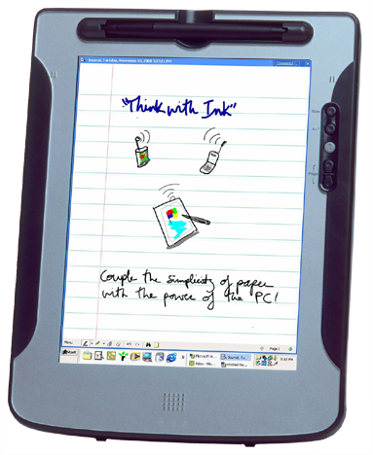
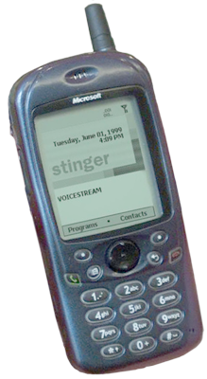
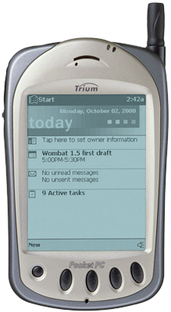
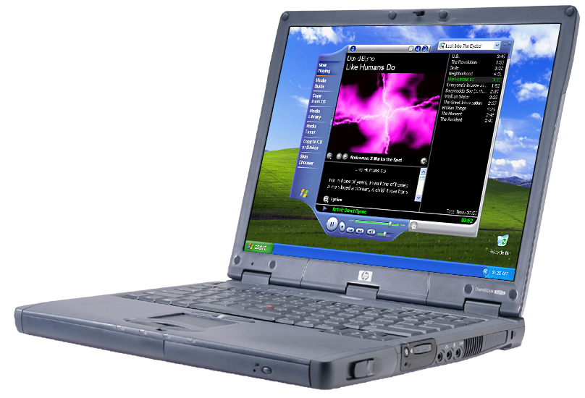
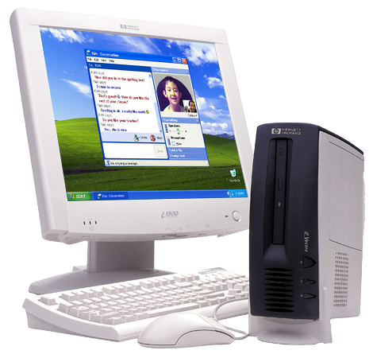
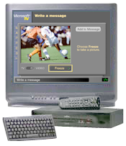
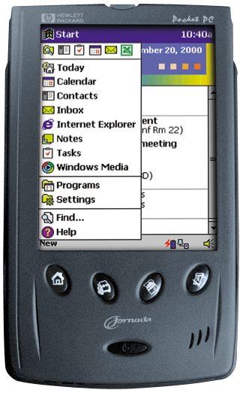
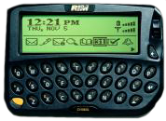
.NET MyServices
Motivation
?
?
?
?
Users have multiple technology islands
Inconsistent, impersonal, user not in control
Islands don’t work well together

Slide 100
.NET MyServices
User-Centric Web Services
.NET Inbox
.NET Alerts
.NET Calendar
.NET Application Settings
.NET Contacts
.NET Documents
.NET Lists
.NET Devices
.NET Categories
.NET Location
.NET FavoriteWebsites
.NET Passport
.NET Presence
.NET Profile
.NET Wallet
Notes:
This figure depicts a series of possible Web Services and the building blocks that compose them, like:
MS Passport – part of MSN
Email
Etc.
This figure also shows how they relate to your site using the Web Services infrastructure that we’ll discuss later in this presentation: SDL, Disco, SOAP, etc.
Instead of using HTTP + HTML for presentation only, the idea is to send and receive information / method calls / results / etc.
Later you’ll be able to integrate these Web Services into your own apps - services like Hotmail and Passport doing service aggregation. And for that you’ll have tools like the SOAP Toolkit (sooner) and VS7 (later) to make this very easy.

Slide 101
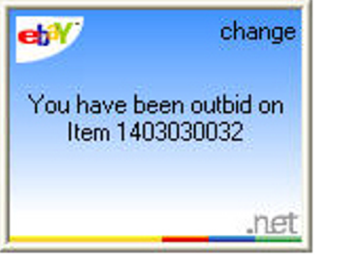
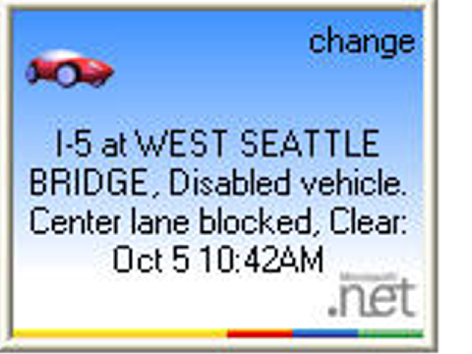
.NET MyServices
.NET Alerts Available Now
Alerts are a better way to touch customers so they can act on new info quickly
  Product shipment
  Outbid at an auction
  …
User in control
  Routed based on user preferences
  Users opt-in and cannot be spammed
You can reach a huge customer base today
  MSN Messenger has more than 40 million users
  Many other end-points: Windows XP, cell phones…
  Alerts SDK here now; test cloud coming later this year
  On the road to .NET My Services

Slide 102
Conclusion
Web Services Overview
Underlying Technologies
Developing a Web Service
Consuming Web Services
Miscellaneous
.NET My Services

Slide 103
Resources
Web Services Essentials
http://msdn.microsoft.com/library/default.asp?URL=
/library/techart/webservicesessentials.htm
SOAP
http://msdn.microsoft.com/soap
SOAP Specification
http://www.w3.org/TR/SOAP/
Don Box on SOAP http://msdn.microsoft.com/msdnmag/issues/0300/soap
/soap.asp
Introduction to SOAP
http://www.w3.org/2000/xp/Group/Admin/minutes-oct1100
/soap-xp-wg_files/frame.htm

Slide 104
Resources
WSDL Specification
http://www.w3.org/TR/wsdl
A Quick Introduction to WSDL
http://msdn.microsoft.com/library/default.asp?url=/library
/enus/soap/htm/soap_overview_72b0.asp?frame=true
UDDI
http://www.uddi.org
http://uddi.microsoft.com
HailStorm
http://www.microsoft.com/net/hailstorm.asp
Building Web Services with SOAP and ASP.NET
http://msdn.microsoft.com/msdnmag/issues/01/02/WebComp
/webcomp.asp

Slide 105
Resources
GXA Web Services Specifications
http://msdn.microsoft.com/library/default.asp?url=/library/en-us/dnsrvspec/html/wsspecsover.asp?frame=true

